Slide 1
Applied Architectures,
Part 2
Software Architecture
Lecture 18

Slide 2
Decentralized Architectures
Networked applications where there are multiple authorities
In other words
  Computation is distributed
  Parts of the network may behave differently, and vary over time
  It’s just like collaboration in the real world

Slide 3
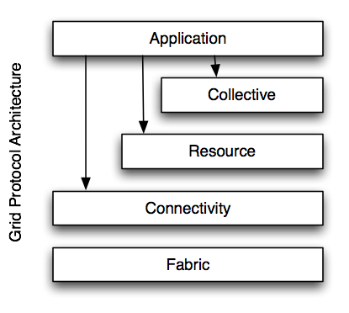
Grid Protocol Architecture
Coordinated resource sharing in a distributed environment
  E.g., Folding-at-home
GLOBUS
  A commonly used infrastructure
“Standard architecture”
  Fabric manages low-level resources
  Connectivity: communication and authentication
  Resource: sharing of a single r.
  Collective: coordinating r. usage
Software Architecture: Foundations, Theory, and Practice; Richard N. Taylor, Nenad Medvidovic, and Eric M. Dashofy; © 2008 John Wiley & Sons, Inc. Reprinted with permission.

Slide 4
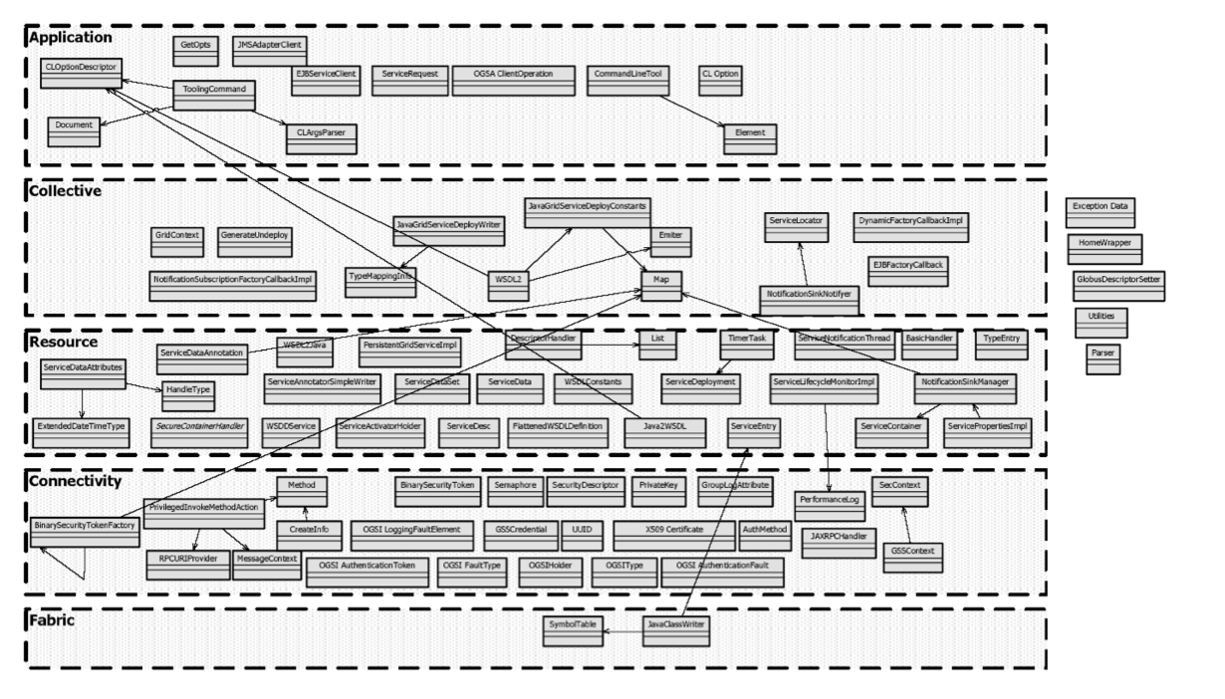
Grid GLOBUS (Recovered)
Software Architecture: Foundations, Theory, and Practice; Richard N. Taylor, Nenad Medvidovic, and Eric M. Dashofy; © 2008 John Wiley & Sons, Inc. Reprinted with permission.

Slide 5
Peer-to-Peer Architectures
Decentralized resource sharing and discovery
  Napster
  Gnutella
P2P that works: Skype
  And BitTorrent

Slide 6
Peer-to-Peer Style
State and behavior are distributed among peers which can act as either clients or servers.
Peers: independent components, having their own state and control thread.
Connectors: Network protocols, often custom.
Data Elements: Network messages
Topology: Network (may have redundant connections between peers); can vary arbitrarily and dynamically
Supports decentralized computing with flow of control and resources distributed among peers. Highly robust in the face of failure of any given node. Scalable in terms of access to resources and computing power. But caution on the protocol!

Slide 7
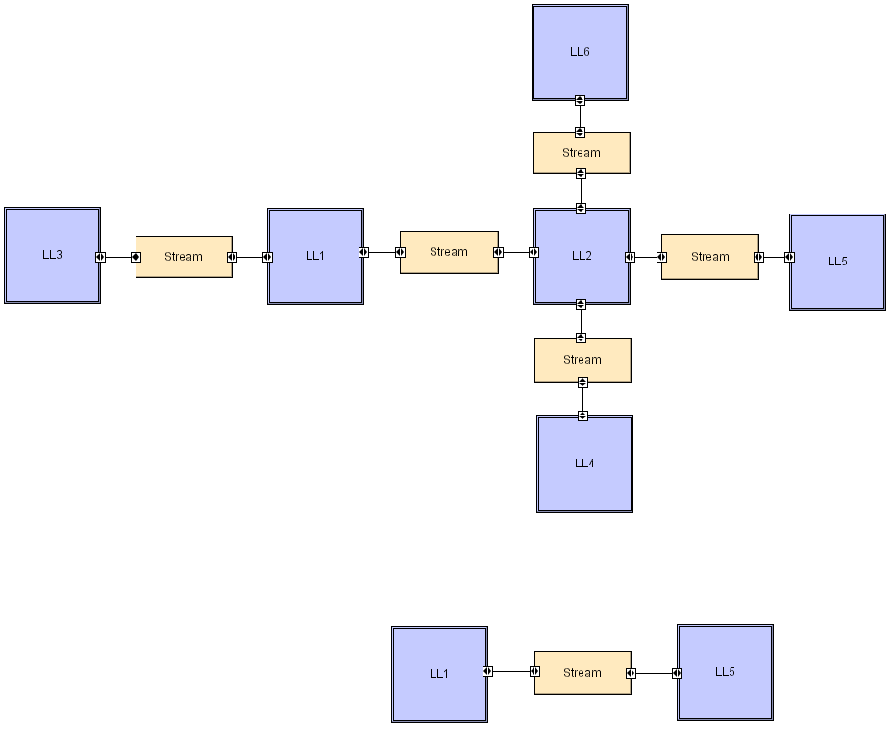
Peer-to-Peer LL
Software Architecture: Foundations, Theory, and Practice; Richard N. Taylor, Nenad Medvidovic, and Eric M. Dashofy; © 2008 John Wiley & Sons, Inc. Reprinted with permission.

Slide 8
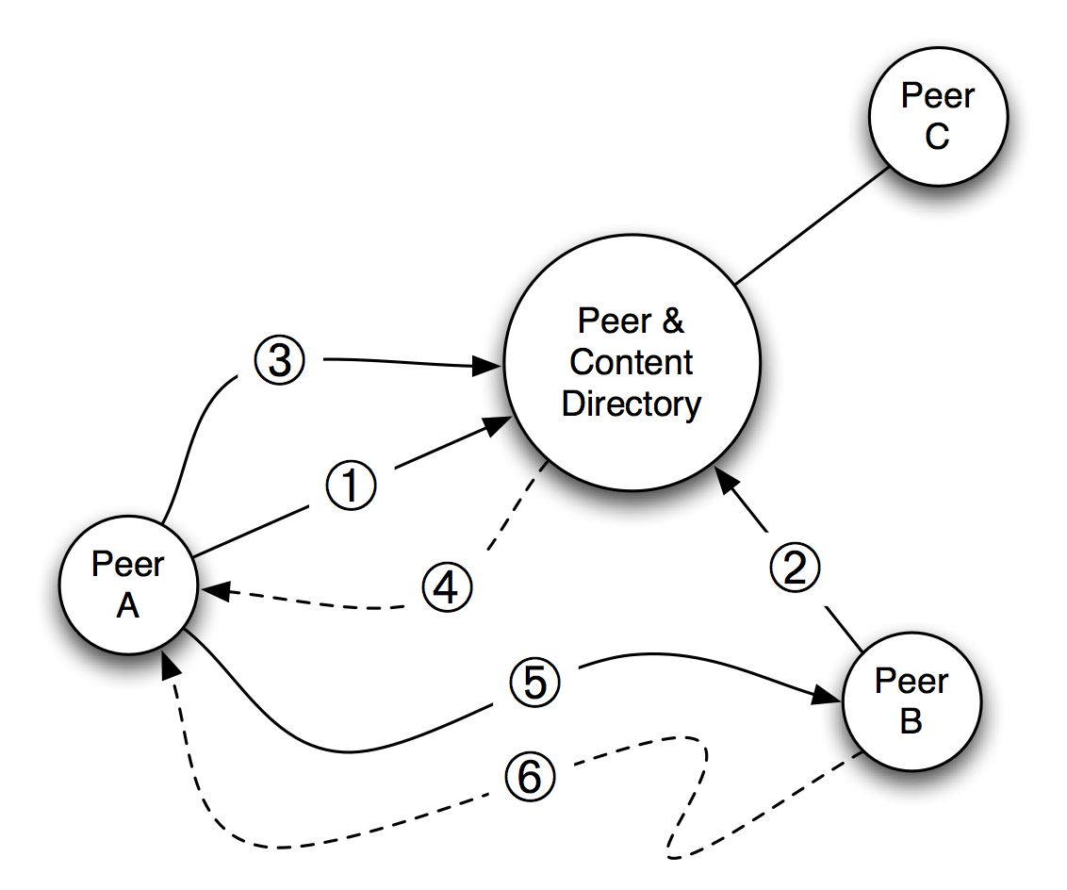
Napster (“I am the Napster!”)
--Lyle, “The Italian Job” (2003)
Software Architecture: Foundations, Theory, and Practice; Richard N. Taylor, Nenad Medvidovic, and Eric M. Dashofy; © 2008 John Wiley & Sons, Inc. Reprinted with permission.

Slide 9
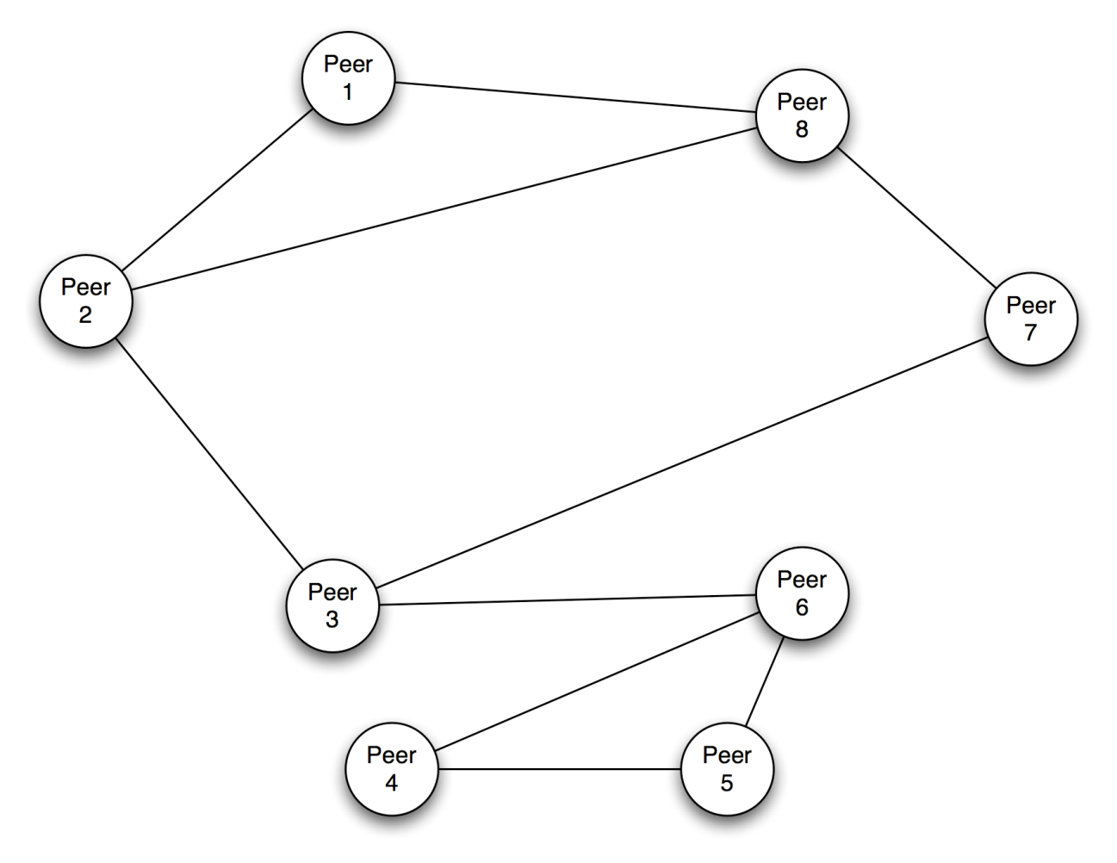
Gnutella (original)
Software Architecture: Foundations, Theory, and Practice; Richard N. Taylor, Nenad Medvidovic, and Eric M. Dashofy; © 2008 John Wiley & Sons, Inc. Reprinted with permission.

Slide 10
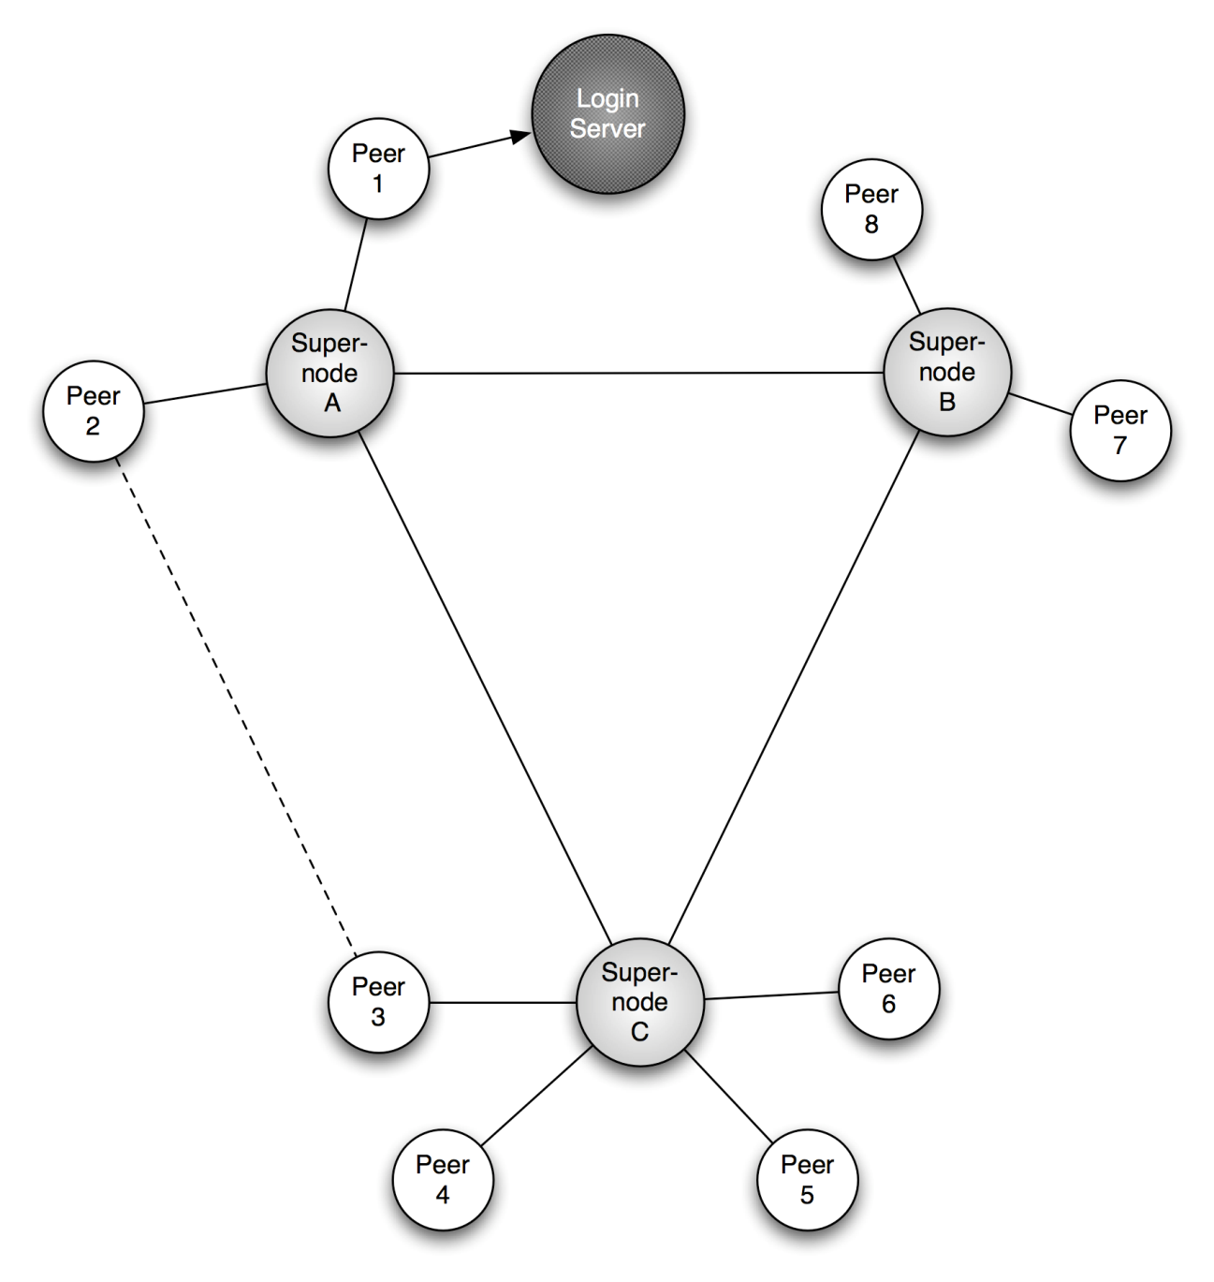
Skype
Software Architecture: Foundations, Theory, and Practice; Richard N. Taylor, Nenad Medvidovic, and Eric M. Dashofy; © 2008 John Wiley & Sons, Inc. Reprinted with permission.

Slide 11
Insights from Skype
A mixed client-server and peer-to-peer architecture addresses the discovery problem.
Replication and distribution of the directories, in the form of supernodes, addresses the scalability problem and robustness problem encountered in Napster.
Promotion of ordinary peers to supernodes based upon network and processing capabilities addresses another aspect of system performance: “not just any peer” is relied upon for important services.
A proprietary protocol employing encryption provides privacy for calls that are relayed through supernode intermediaries.
Restriction of participants to clients issued by Skype, and making those clients highly resistant to inspection or modification, prevents malicious clients from entering the network.

Slide 12
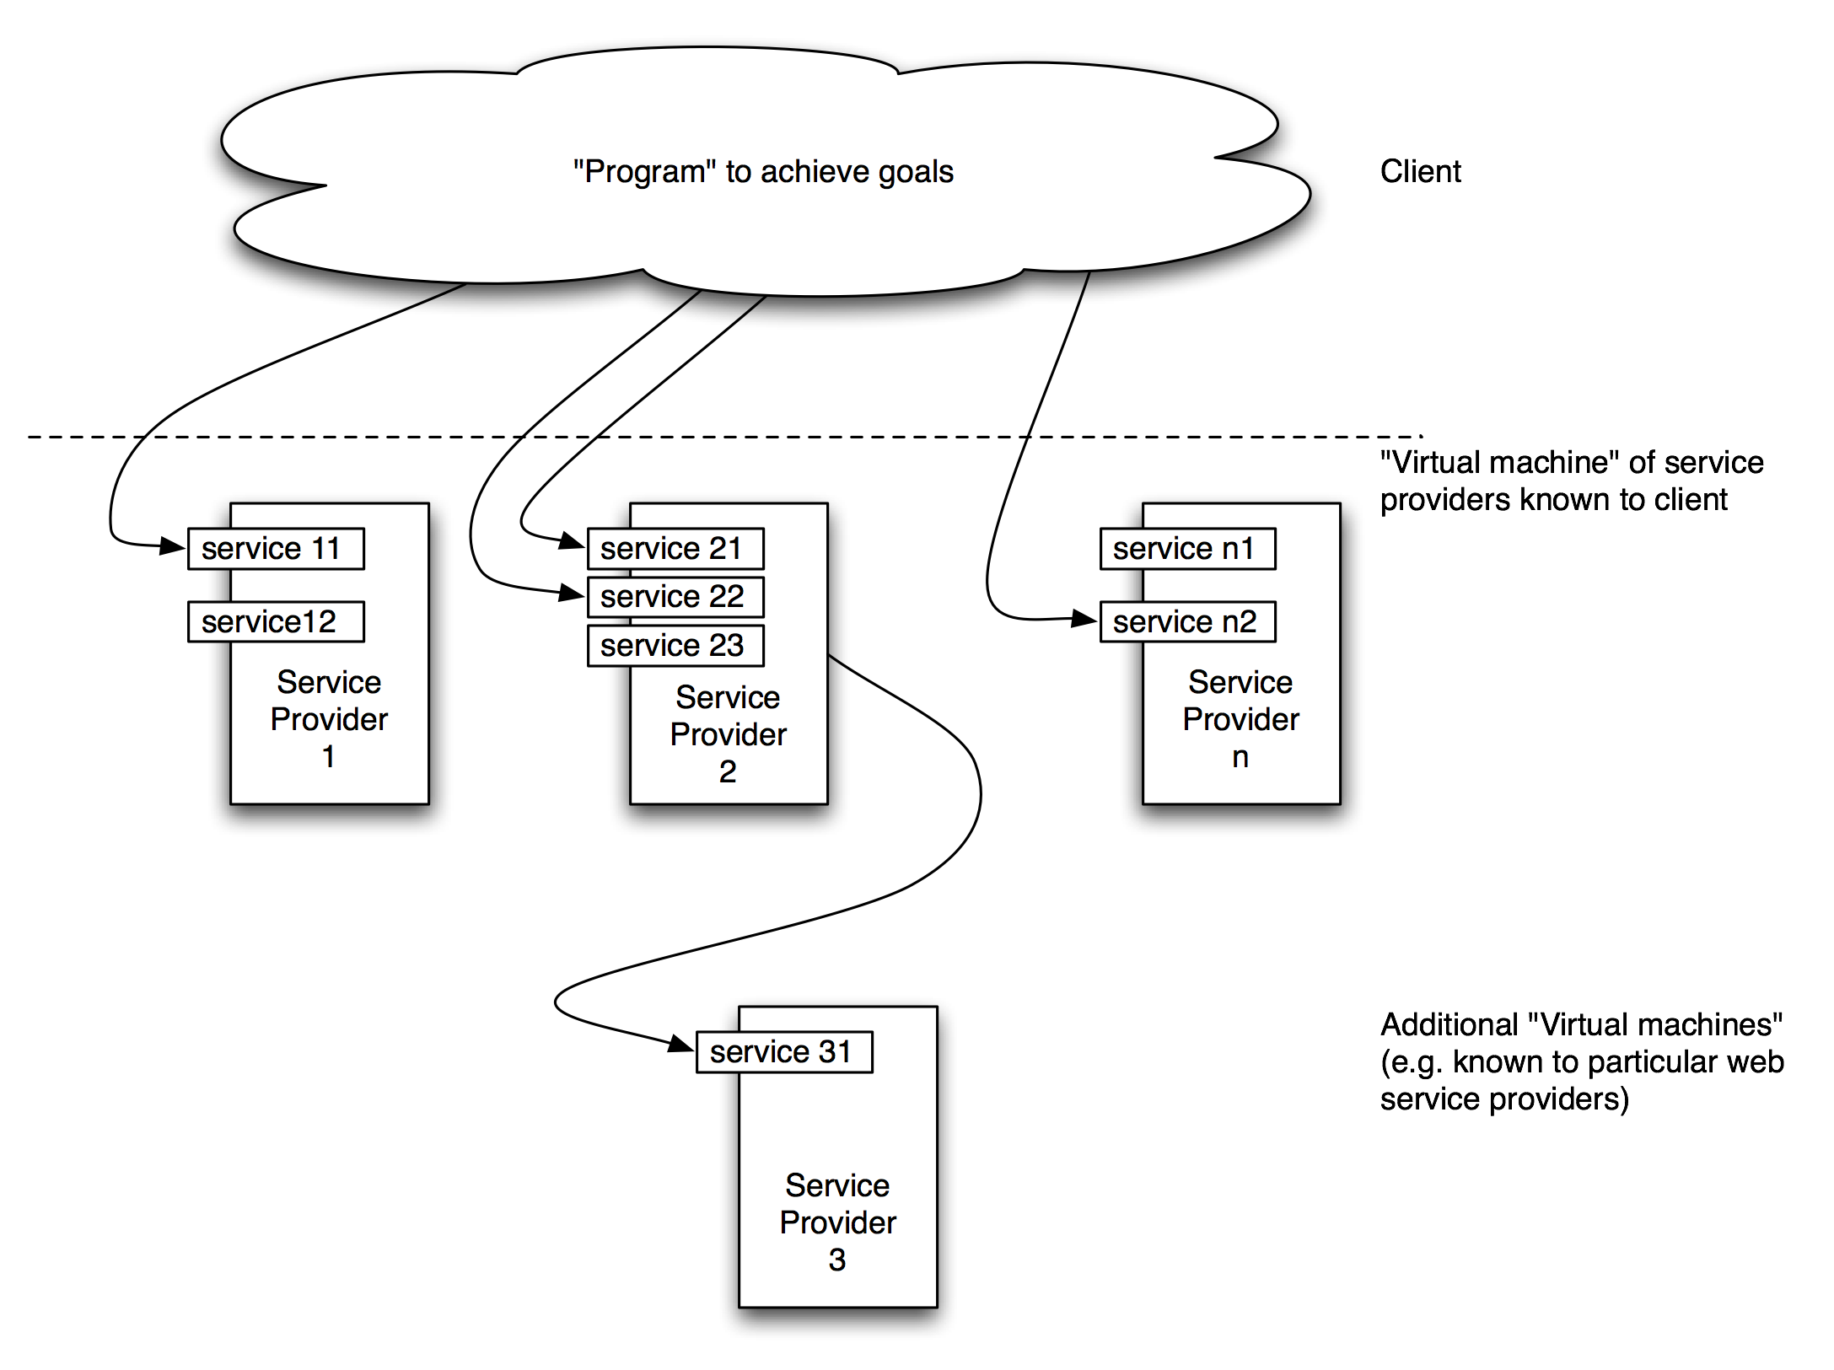
Web Services
Software Architecture: Foundations, Theory, and Practice; Richard N. Taylor, Nenad Medvidovic, and Eric M. Dashofy; © 2008 John Wiley & Sons, Inc. Reprinted with permission.

Slide 13
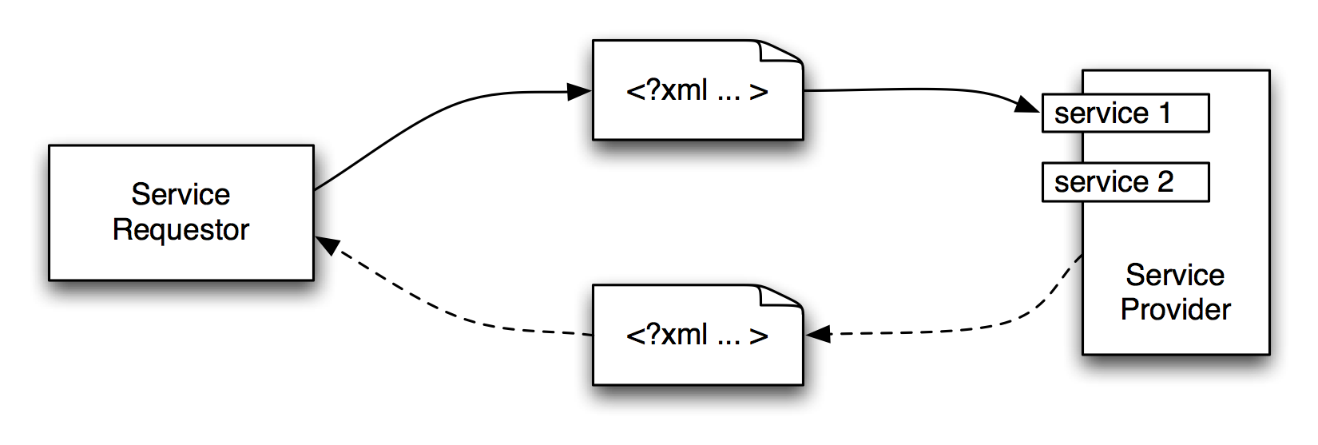
Web Services (cont’d)
Software Architecture: Foundations, Theory, and Practice; Richard N. Taylor, Nenad Medvidovic, and Eric M. Dashofy; © 2008 John Wiley & Sons, Inc. Reprinted with permission.

Slide 14
Mobile Robotics
Manned or partially manned vehicles
Uses
  Space exploration
  Hazardous waste disposal
  Underwater exploration
Issues
  Interface with external sensors & actuators
  Real-time response to stimuli
  Response to obstacles
  Sensor input fidelity
  Power failures
  Mechanical limitations
  Unpredictable events

Slide 15
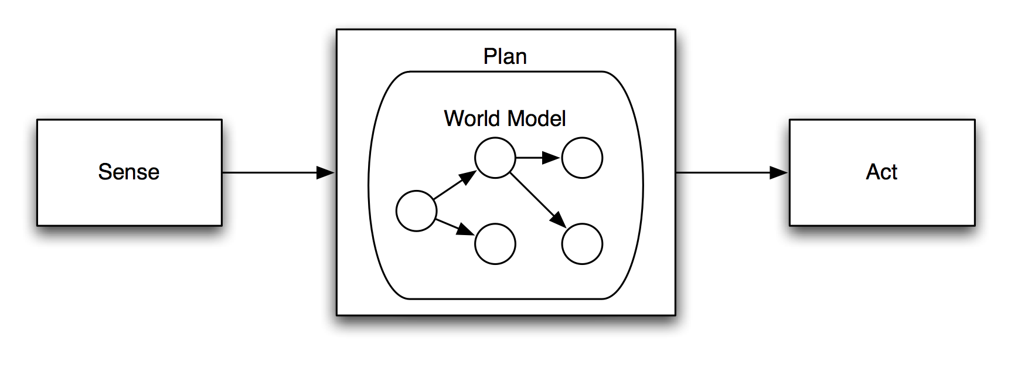
Robotics: Sense-Plan-Act
Software Architecture: Foundations, Theory, and Practice; Richard N. Taylor, Nenad Medvidovic, and Eric M. Dashofy; © 2008 John Wiley & Sons, Inc. Reprinted with permission.

Slide 16
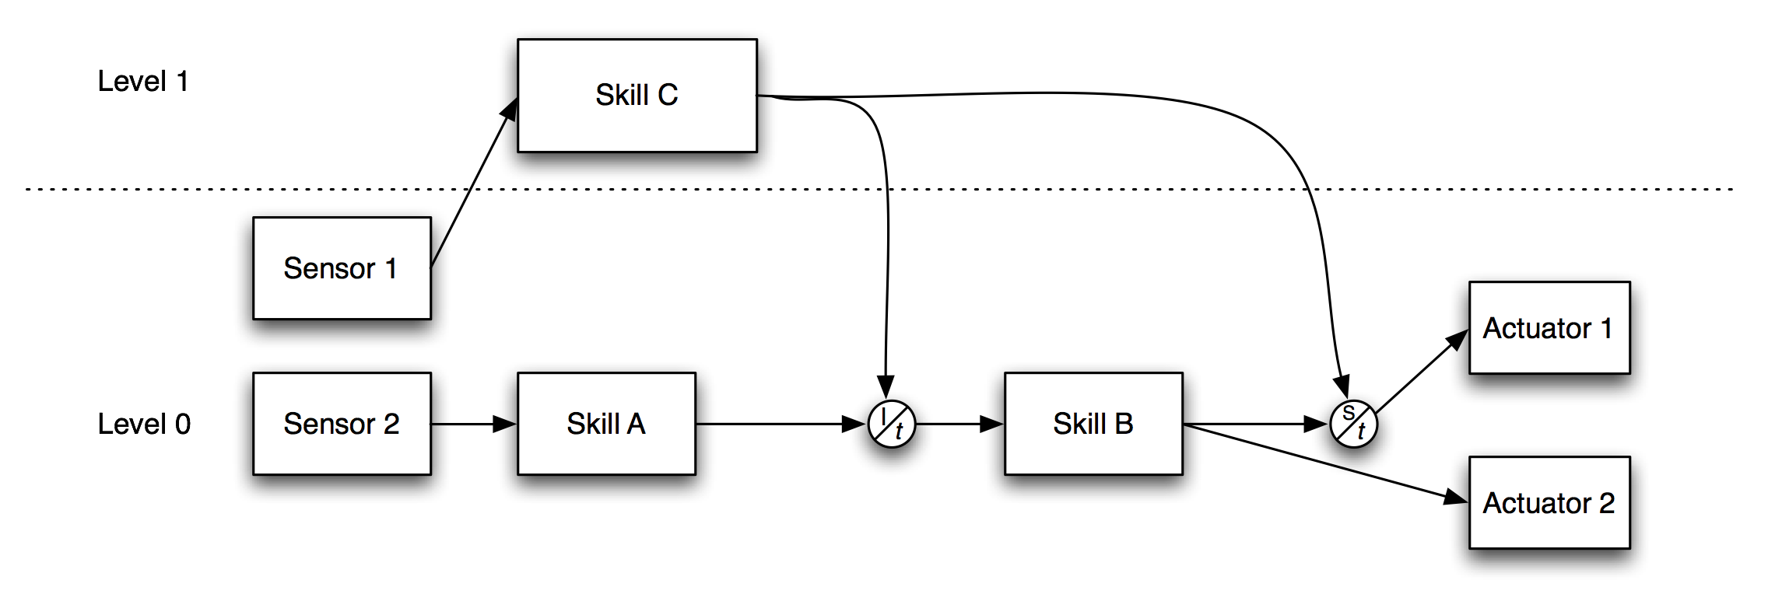
Robotics Subsumption Architecture
Software Architecture: Foundations, Theory, and Practice; Richard N. Taylor, Nenad Medvidovic, and Eric M. Dashofy; © 2008 John Wiley & Sons, Inc. Reprinted with permission.

Slide 17
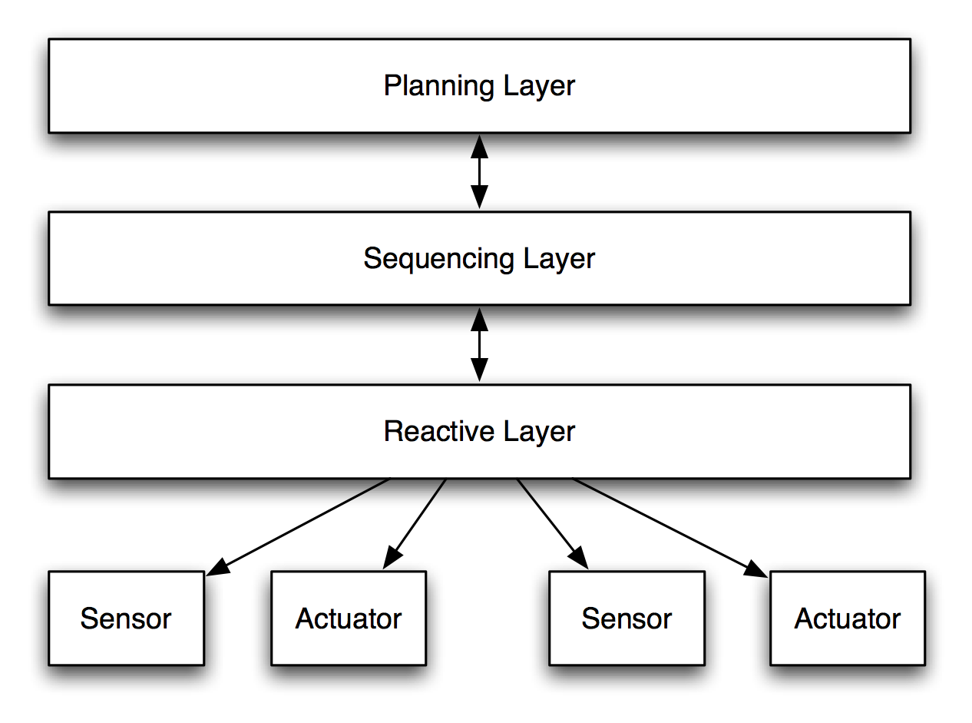
Robotics: Three-Layer
Software Architecture: Foundations, Theory, and Practice; Richard N. Taylor, Nenad Medvidovic, and Eric M. Dashofy; © 2008 John Wiley & Sons, Inc. Reprinted with permission.

Slide 18
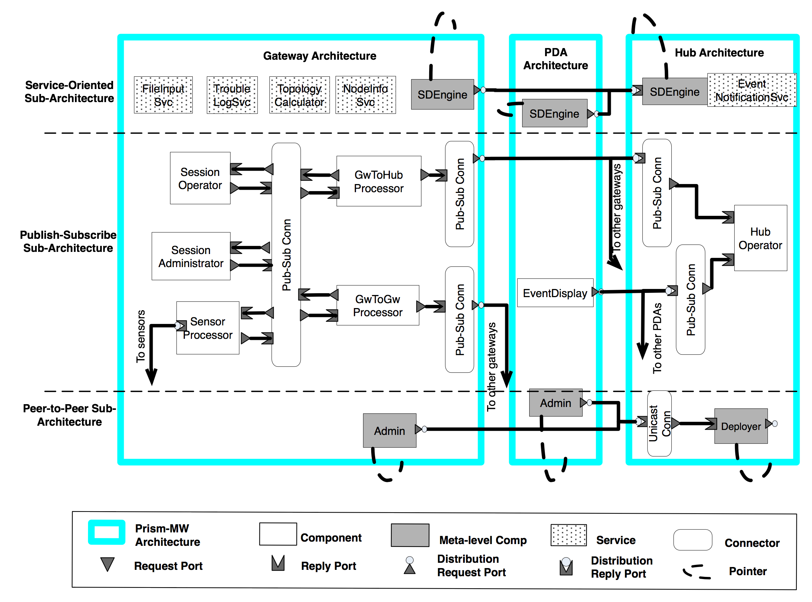
Wireless Sensor Networks
Software Architecture: Foundations, Theory, and Practice; Richard N. Taylor, Nenad Medvidovic, and Eric M. Dashofy; © 2008 John Wiley & Sons, Inc. Reprinted with permission.

Slide 19
Flight Simulators: Key Characteristics
Real-time performance constraints
  Extremely high fidelity demands
    Requires distributed computing
    Must execute at high fixed frame rates
      Often called harmonic frequencies
        e.g. often 60Hz, 30Hz; some higher (100Hz)
  Coordination across simulator components
    All portions of simulator run at integral multiple of base rate
      e.g. if base rate = 60Hz, then 30Hz, 15Hz, 12Hz, etc.
    Every task must complete on time
      Delays can cause simulator sickness

Slide 20
Flight Simulators: Key Characteristics (cont’d)
Continuous evolution
Very large & complex
  Millions of SLOC
  Exponential growth over lifetime of simulator
Distributed development
  Portions of work sub­contracted to specialists
  Long communication paths increase integration complexity
Expensive verification & validation
  Direct by-product of above characteristics
Mapping of Simulation SW to HW components unclear
  Efficiency muddies abstraction
  Needed because of historical HW limitations

Slide 21
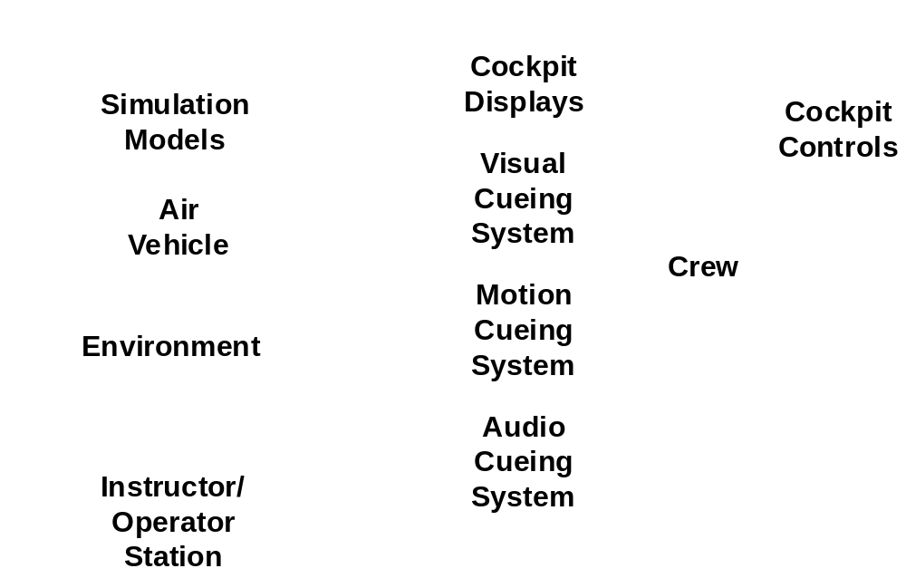
Functional Model
Notes:
A flight simulator must provide a great number and great variety of services to its users.
crew being trained: pilot, co-pilot, navigator, and weapons personnel (if this is a military simulator)
"instructor-operator".
In charge of the pedagogical aspects of flight simulation
Decides what mission will be run, and under what conditions
Controls the simulation in real time
Runs simulation, insert malfunctions (in order to test the flight crew's response to emergency situations), or freezes simulation if some pedagogical point is to be made.
Simulator must provide visual, audio and motion cues to the users-the aircrew. In addition, some simulators will have to provide a force-feed­back cues. These sensory cues are generated in order to provide the sights, sounds and feel of a normal air vehicle. The software must also simulate the air vehicle's normal set of instruments. These must all be simulated to a high degree of fidelity, with a high degree of coordination (in order to avoid simulator sickness).
The aircrew will be responding to their environment in real-time. Some of these responses are continuous (the pilot's "stick", for example), and some will be events (changing the setting of a switch). These responses will need to be communicated back to the software simulation as they change the state of the simulation. In addi­tion, as the air vehicle is being navigated, the environment through which it is passing changes, which will, in turn, affect both the sensory inputs being fed to the aircrew, and the state of the simulation.

Slide 22
How Is the Complexity Managed?
New style
  “Structural Modeling”
  Based on
    Object–oriented design to model air vehicle’s
      Sub-systems
      Components
    Real-time scheduling to control execution order
Goals of Style
  Maintainability
  Integrability
  Scalability

Slide 23
How Is the Complexity Managed? (cont’d)
Style principles
  Pre-defined partitioning of functionality among SW elements
  Restricted data- & control-flow
    Data-flow through export areas only
      Decoupling objects
  Small number of element types
    Results in replicated subsystems
Notes:
Functionality is partitioned into
objects analogous to aircraft components: pumps, actuators, valves, etc.
few classes of objects,
all objects within a class
look the same
have the same entry points (or methods).
Parts of a simulation for which no real-world analogy (such as data gatherers)
modeled in the same way as the real-world entities
using the same software structures.
Minimizing the number of base types
Goal
Provide higher-level commonalities among groupings of objects
Encapsulate patterns of system behavior at a high level of abstraction.
Eases the development of large systems.
Every part of the system is composed of the same small set of base types
the system is more regular,
easier to
communicate,
learn,
review,
modify.
Fixed control patterns
Easier to understand & analyzed temporal depen­dencies to be more
Data Flow through export areas
Reduces dependencies & coupling
Objects don’t need to know identity of other object to communicate
Message traffic is channeled so can be easily
Controlled
Monitored
Measured
Limited coordination strategies
Reduces programmer assumptions about time relations
Makes easier to distribute & control

Slide 24
How Is the Complexity Managed? (cont’d)
Style principles (continued)
  Objects fully encapsulate their own internal state
  No side-effects of computations
  Narrow set of system-wide coordination strategies
    Employs pre-defined mechanisms for data & control passing
    Enable component communication & synchronization
Notes:
Functionality is partitioned into
objects analogous to aircraft components: pumps, actuators, valves, etc.
few classes of objects,
all objects within a class
look the same
have the same entry points (or methods).
Parts of a simulation for which no real-world analogy (such as data gatherers)
modeled in the same way as the real-world entities
using the same software structures.
Minimizing the number of base types
Goal
Provide higher-level commonalities among groupings of objects
Encapsulate patterns of system behavior at a high level of abstraction.
Eases the development of large systems.
Every part of the system is composed of the same small set of base types
the system is more regular,
easier to
communicate,
learn,
review,
modify.
Fixed control patterns
Easier to understand & analyzed temporal depen­dencies to be more
Data Flow through export areas
Reduces dependencies & coupling
Objects don’t need to know identity of other object to communicate
Message traffic is channeled so can be easily
Controlled
Monitored
Measured
Limited coordination strategies
Reduces programmer assumptions about time relations
Makes easier to distribute & control

Slide 25
F-Sim In The Structural Modeling Style
Five basic computational elements in two classes
  Executive (or infrastructure)
    Periodic sequencer
    Event handler
    Synchronizer
  Application
    Components
    Subsystems
Each of the five has
  Small API
  Encapsulated state
  Severely limited external data upon which it relies
Notes:
two main sets of con­cerns: executive and application.
executive handles coordination issues:
real-time scheduling of sub-systems,
synchronization between processors,
event management from the instructor-opera­tor station,
data sharing, and
data integrity
application handles computation
modeling the air vehicle

Slide 26
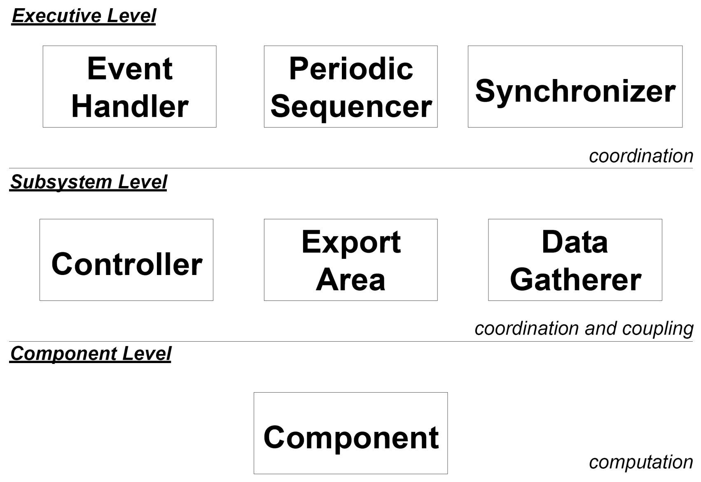
Level–0 Architecture
Notes:
timeline synchronizer
controls data accesses, periodic processing and event processing by scheduling the periodic sequencer and the event handler
maintains syn­chronization with other processes
periodic sequencer
Handles the regular scheduling of sub-systems when it is invoked through its periodic processing operation
event handler
Handles aperiodic events principally from the instructor-operator station
Sub-system Controllers
coordinate the activities of the purely computational com­ponents
group these components into meaningful collections which represent sub-systems within the air vehicle:
hydraulics,
air-frame,
fuel,
braking,
engines
sub-system invokes each component in turn, passing it the relevant state data
Components
models of things like reservoirs, valves, turbines, and actuators
do the actual simulation computation

Slide 27
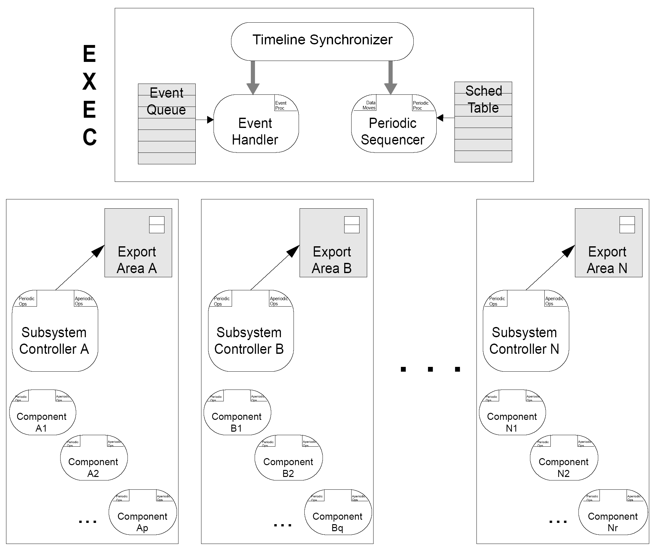
Level–1 Architecture

Slide 28
Takeaways
A great architecture is the ticket to runaway success
A great architecture reflects deep understanding of the problem domain
A great architecture probably combines aspects of several simpler architectures
Develop a new architectural style with great care and caution. Most likely you don’t need a new style.

